Slide 1
Development of Fire fighting foam from 2000
CTIF meeting Frankfurt
10/11 sept 2014
By: Joop Rijnbout

Slide 2
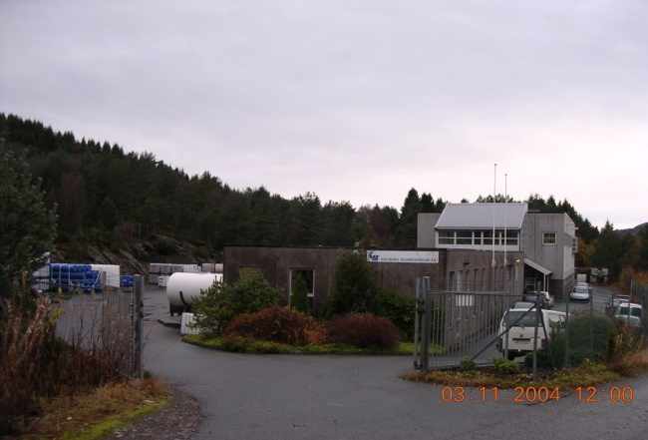
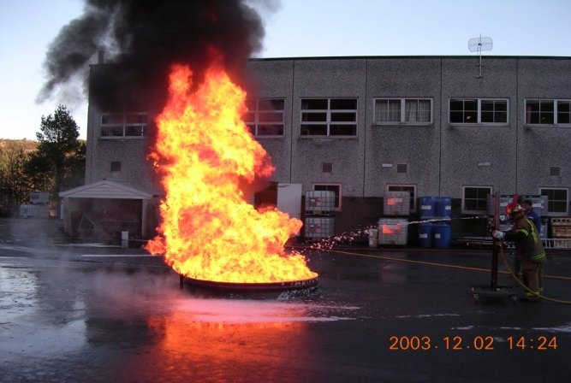
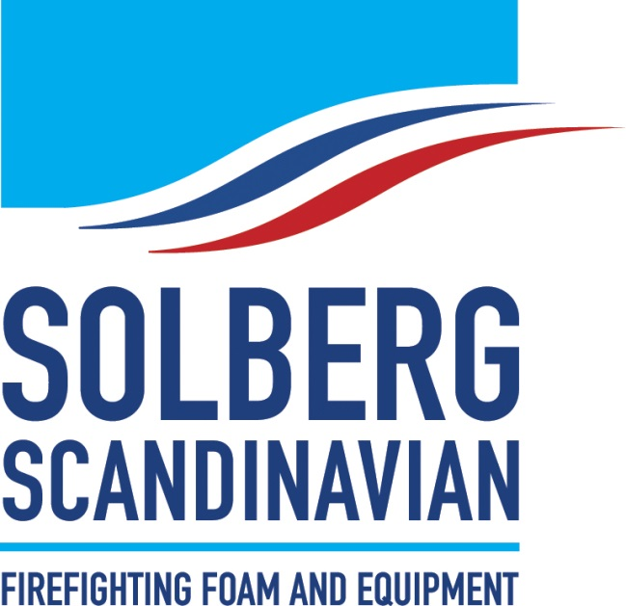
Organisation
Norway
USA
Australian

Slide 3
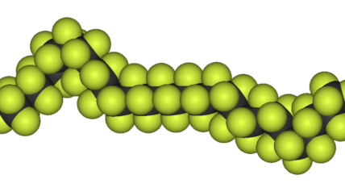
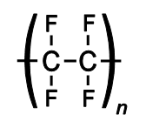
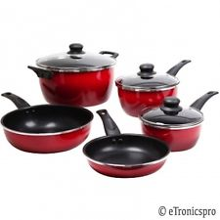
Perfluorcarbons (PFC)
The presence of PFOS and PFOA and their negative impact on the environment was and is an engine to develop new types of fire fighting foams .
Short chain lenght 1-4 Carbon atoms gaseous
Medium sized chain lenght 4-12 Carbon atoms liquids
These fluor-telomers are used in AFFF’s
Long chain lenght (Fluorpolymers) solid
Teflon

Slide 4
Till 2001
Most used fire fighting foams:
AFFF and AFFF/ATC (AFFF/AR)
- Film forming foam concentrates were based on PFOS and PFOA
- Amount PFOS substantial higher than PFOA.
- 3M stops production of Fluor chemicals (May 2000).
- Many foam concentrates contain fluor surfactants from 3M
From 2001:
Fluor surfactants can still contain PFOA or biodegrate to it.

Slide 5
2006
PFOA : more reservations to this molecule.
In 2006 : convenant between tussen EPA and the 8 biggest producers of fluorchemicals.
Result: Stewardship Program 2010/2015.
- 2010 reduction of PFOA with 95% with respect to 2000
- 2015 reduction PFOA to 100%
Only option to go away from C-8 technology.
To change to C-6 technology.

Slide 6
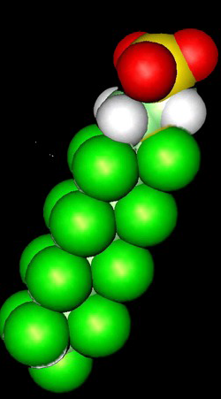
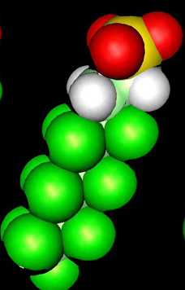
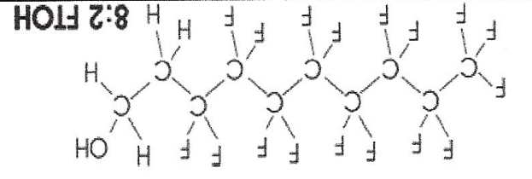
C8-------------------C6 Technology AFFF en AFFF/ATC
C8 -technology: 17 fluoratoms (C8:2 FTS)
C6 –technology: 13 fluoratoms (C6:2FTS)
25 % less fluor worse performance
More F-surfactants for same performance New approvals
(products more expensive)
Duurdere Producten en
6:2 FTOH

Slide 7
Why Fluor free fire fighting foams?
More and more scientists have the suspicion that Fluor-chemicals and other Organohalogens( CL,BR en I) have a negative influence on the environment.

Slide 8
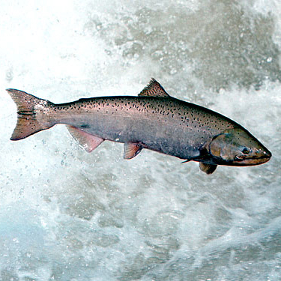
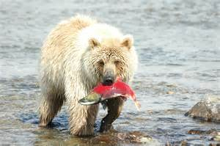
Perfluorcarbons
PFC are persistent and found in the ice bear
Not bio-degradable
Toxic profile
Food chain

Slide 9
Situation Germany
Important players
Governments of the 15 states
UBA
VDS
Watertreatment companies

Slide 10
UBA recommandations
If there is a suitable replacement for an AFFF or AFFF/ATC we recommend to use such one.
Collect the effluet in case an AFFF, AFFF/ATC were used.
Don’t use AFFF and AFFF/ATC for trainings purposes.
Many water treatment companies don’t accept waste water which contains fluor- chemicals.
For more info, see website:
www.umweltbundesambt.de/producte/pfc/

Slide 11
VDS expectations
Expectations
They expect a general ban of the use of PFC.

Slide 12
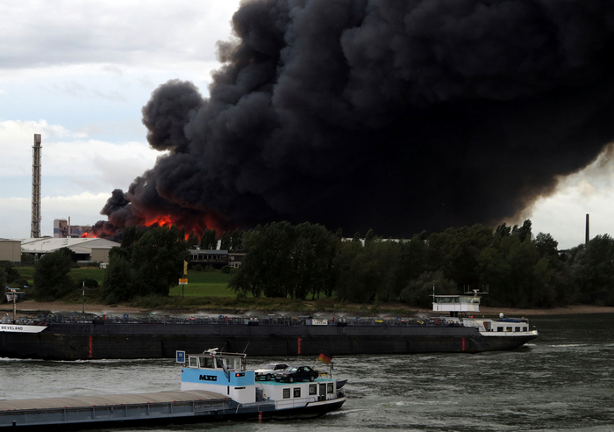
Fire Krefeld September 2012
We claim your foam concentrate .........
No PFC containing foam will be allowed to use........

Slide 13
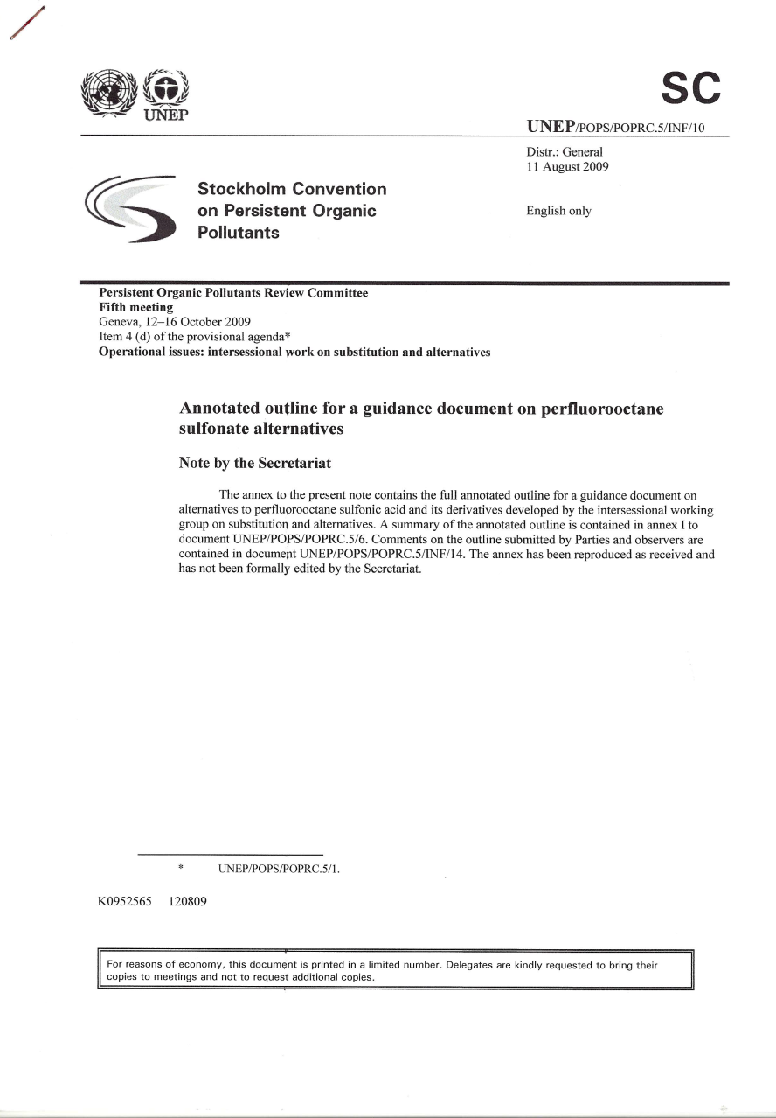
Publications
August 2009
July 2009
June 2013

Slide 14
Fluor free fire fighting foams
From 2004 available ( Australia)
Contain no: Fluor-telomers (short chains) Fluor-polymers (long chains) (sometimes present!)
Organo-halogen free: best definition to be sure that a recommended product contains no Fluor at all.

Slide 15
Changes in documents
SDS
Reach (2008)
Reach (2015). More info about raw materials
Approvals
EN 2008 (main changes: Material of fire pan. Part 4 IPA and Aceton)
ICAO published a higher level (ICAO-C)

Slide 16
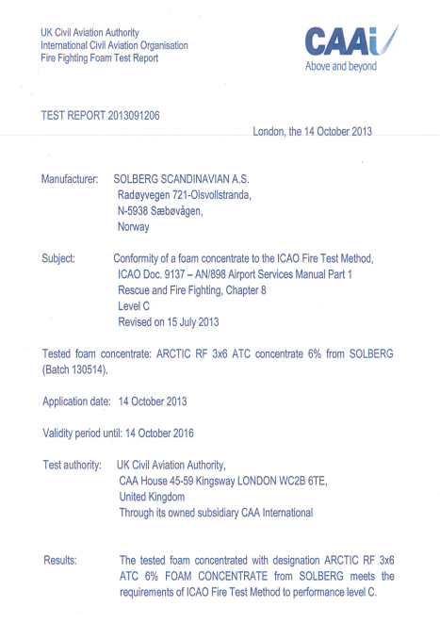
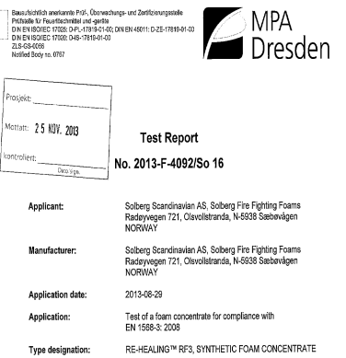
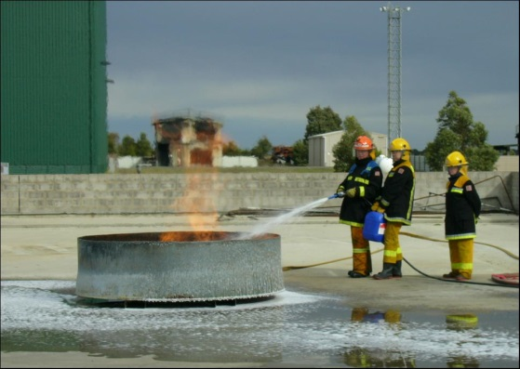
Fire fighing foam information
Not all Fluoro free foams have all below mentioned info available.!!
Product information sheet
Safety data sheets (REACh)
Environmental information- Hygiene Instituut
Approvals:
- EN 1568
- ICAO (Aviation)
- IMO (Marine)
- UL
- Lastfire (refineries)
Tests + reports
Technical information
References
Airport test organisation
Often small

Slide 17
RF-Foam FLUORFREE

Slide 18
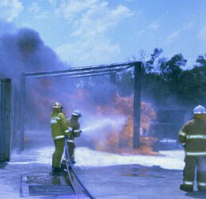
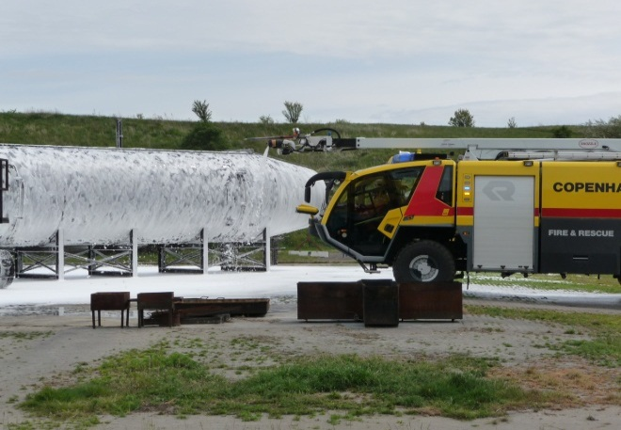
Characteristics of Re-Healing Foams
Pseudoplastic
Extinguish properties simular to AFFF and AFFF/ATC
To use with fresh,sea and brackish water
Powder compatible
Good sticking properties
Usable with all wellknown equipment and proportioner systems systems
Powder
sticking

Slide 19
Working RF (RE-HEALING) foam
Flammable liquid
Easy to expand
Foam bubbles of different sizes
Bigger bubbles collapse to water film with very short life time but will spread the smaller one’s fast over the surface.
Smaller bubbles have stronger walls and long draintime resulting in a very good burnback resistance.

Slide 20
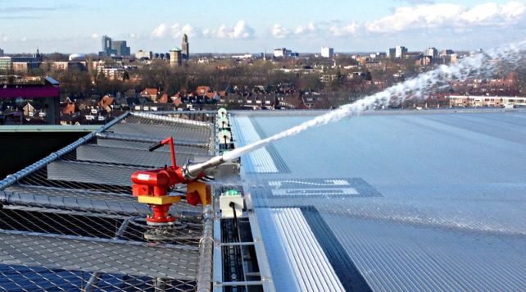
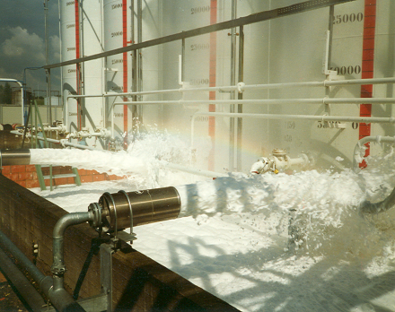
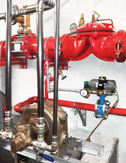
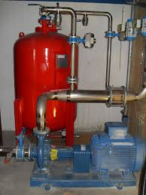
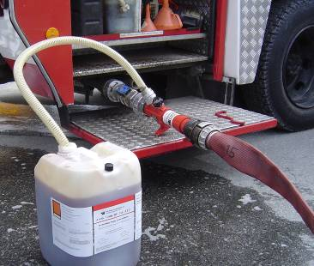
Equipment
No expanded equipment
Low expanded equipment
Medium expanded equipment
High expanded equipment
CAFS
Sprinklers

Slide 21
RE-HEALING Concentrates
Available Concentrates:
Hydrocarbons : 1%, 3% & 6%
Idem + Polair solvents : 3% x 6%
Class A + Biofuels : 3%
Approvals
- EN 1568 part 3 and 4
- ICAO- B (3% and 6%)
- ICAO- C , on our 3 x 6
- UL
- Lastfire

Slide 22
References Airport
Dubai
Copenhagen
Bristol
Koln/Bonn
Stuttgart
Bilund
Guernsey
24 airports Australia: Melbourne,Sidney, Canberra,Adelaide etc
Over 20 helidecks in Europe

Slide 24
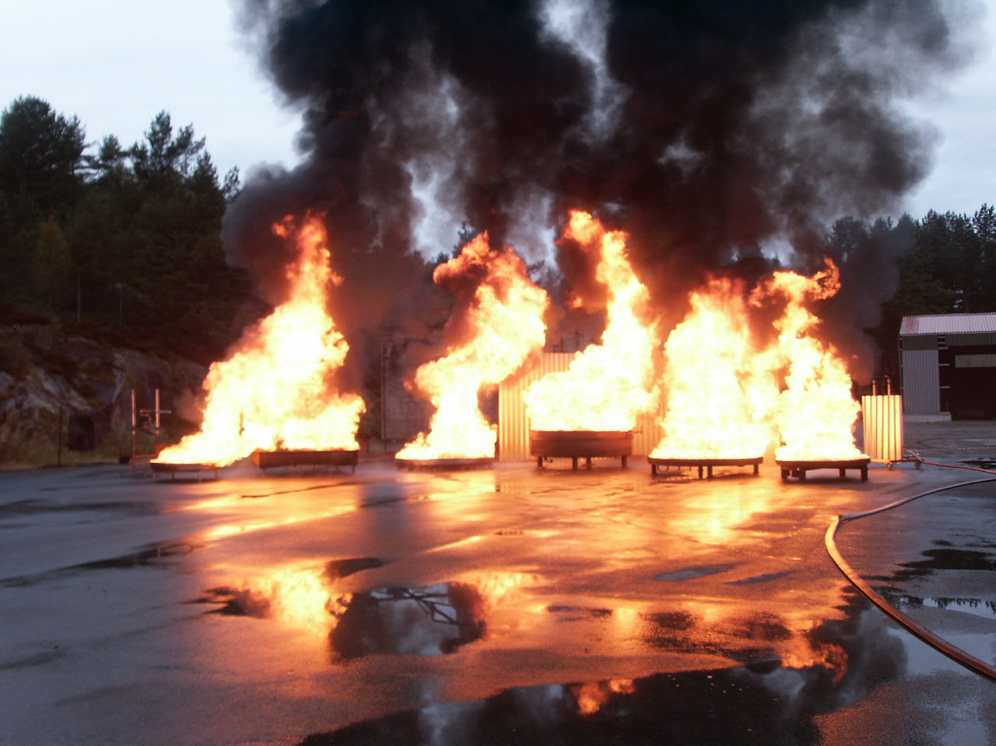
Test pans
MIL-F
LASTFIRE
EN
UL

Slide 25
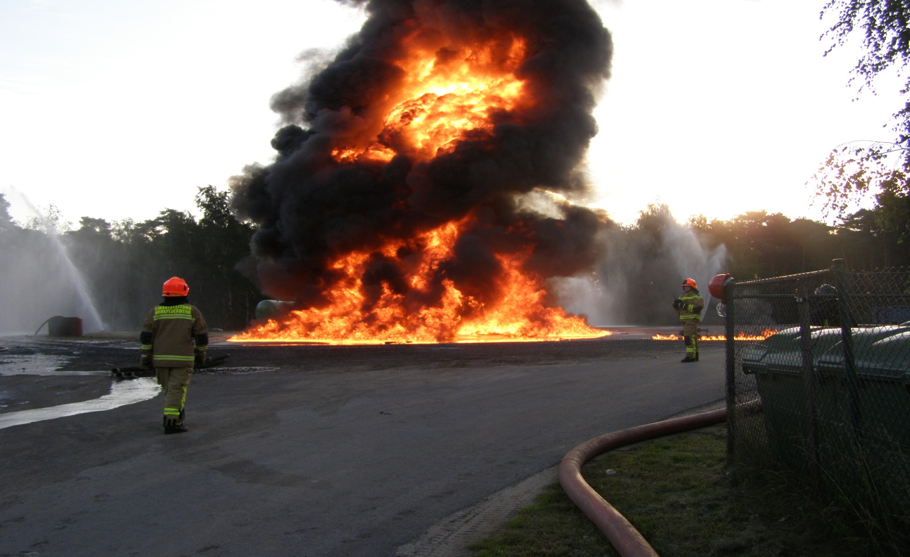
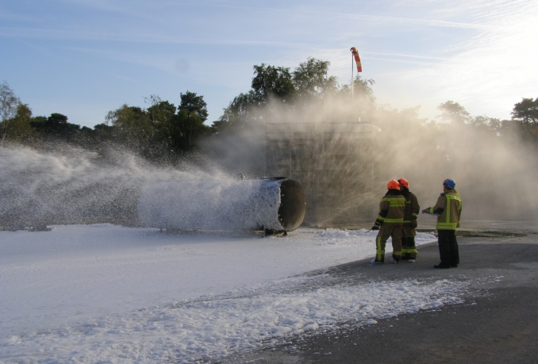
Big scale tests
330 m2
Hexane 1300 liter/min
extinguished 41 sec

